Slide 1
Regular Expressions
Eric Freeman

Slide 2
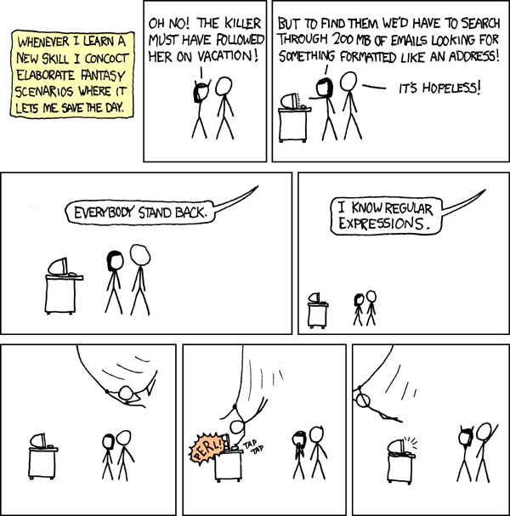
Brief History
Pattern matching against text
Also used for find and replacing
Stephen Kleene invented regex in the 1950’s
Many different implementations all with their different quirks

Slide 3
Literal Text
HTTP/
200
HTTP/
1.2
200
HTTP/
1.1
303
See Other Location: …
WARNING: Some languages use ‘/’ as a special character so you’ll have to ‘escape’ it which you’ll learn more about soon!

Slide 4
Characters
\d – one digit
\w – one “word” character (letter, underscore, or digit)
\s – one which space
\b – word boundary
. – any character except new line
^ - new line
$ - end of line
\D – one non digit character
\W – one non “word” character
\S – one non space character
\B – not a word boundary

Slide 5
Escape Characters
A backslash will escape the next character allowing you to use one of regex’s reserved characters
Some characters you’ll need to escape: \, *, +, ?, |, {, [, (, ), ^, $, ., #

Slide 6
Bringing it all together
HTTP/
HTTP/1\.\d\s
HTTP/1\.\d\s\d\d\d
HTTP/
1.2
200
HTTP/
1.1
303
WARNING: Remember to escape the period!

Slide 7
Character Classes
[] specifies a character class (or ‘character set’)
Tells the regex engine to match only one of several characters you specify
‘gray’ and ‘grey’ can both be captured with ‘gr[ae]y’
A hypen specifies range. ‘[a-zA-Z]’ will match on any single lower or uppercase letter
Putting ‘.’ or ‘-’ in a character class doesn’t require them to be escaped if they go at the beginning or end
WARNING: Have fun matching languages besides English with the previous notation. Spanish will look more like this: ‘[aábcdeéfghijklmnñoópqrstuúüvwxyzAÁBCDEÉFGHIJKLMNÑOÓPQRSTUÚÜVWXYZ]’
Negate with a ‘^’: [^0-9] matches anything but 0 through 9

Slide 8
Alternation
‘or’ logic with the pipe ‘|’
cat|dog
Can match on multiple letters unlike character class

Slide 9
Quantifiers
Used to specify repetition of previous string literal, character, character class, capture group, etc.
+ - one or more
* - zero or more
? - optional
\d+ will match an entire number instead of just first digit
<[a-zA-Z][a-zA-Z0-9]*> will match any opening html tag like <head>, <title>, <h3>, etc.
colou?r will match both color and colour

Slide 10
Capture Groups
Wrapping what you’re capturing in a pair of parenthesis will put it in a capture group
Can be combined with quantifiers
Capture groups can be selected from the Match object in c# (which you’ll need to use for the exercises coming up!)
To use a capture group for it’s grouping effect but not make it selectable from the Match object in .NET, you can make it passive:
(?:https?|ftp):// can be useful when parsing valid URLs, but you might not want to ever use it later

Slide 11
Bringing It All Together
Usernames are allowed to be upper and lower case letters, numbers, underscores, and periods.
^[a-zA-Z0-9._]+$
magic_mage123
xXx1337h4x0rxXx
dude-man_bro
Xsniper.hunterX
super\puncher

Slide 12
DO LEVEL 1 & 2 TESTS NOW
git@github.com:EricFreeman/RegexKatas.git

Slide 13
Greedy vs. NonGreedy
? – can be used to make quantifier nongreedy by matching only first instance (e.g. \d+? matches ‘1’ in ‘12345’)
Example: “text” “blah blah blah” “testtesttest” “12345” “ABC123”
“.*” will match the entire text in one group
“.*?” will match each quotation separately

Slide 14
Quantifiers Cont.
You can use {\d+ (, (\d+)?)?} to match a specific amount of a given token, or a range.
{3} – matches exactly three of whatever precedes it
{3,} – matches three or more instances
{3,5} – matches between three and five instances

Slide 15
LookaROUNDS
Used to look ahead or behind for match, but without moving where you’re anchored.
Types:
Positive Lookahead - (?=)
Negative Lookahead - (?!)
Positive Lookbehind - (?<=)
Negative Lookbehind - (?<!)

Slide 16
DO LEVEL 3 TESTS NOW
git@github.com:EricFreeman/RegexKatas.git

Slide 17
Useful Links
Further Reading
http://www.rexegg.com/
http://www.regular-expressions.info/
Online Regex Parsers
http://www.regexr.com/
http://rubular.com/

